Slide 1
June 2020 Webinar – COVID-19: How We Ask Questions, Collect the Data and What Do We Learn?
PRESENTED BY
Constanza Cilley – Voices! Executive Director

Slide 2
SOME FACTS ABOUT COVID-19 IN ARGENTINA
18.319
confirmed cases
569
deaths
Source: Johns Hopkins https://coronavirus.jhu.edu/data/mortality | Date June 3rd

Slide 3
SOME FACTS ABOUT COVID-19 IN ARGENTINA
The first case of coronavirus was diagnosed on March 3rd
Kids do not attend school since March 16th
Quarantine was established on March 20th.
We are in day 76 of strict coercive quarantine

Slide 4
SOME FACTS ABOUT COVID-19 IN ARGENTINA
Strong concentration in Buenos Aires metropolitan area (+80%)
Growing rapidly in shanty towns (1/2 of Federal District new cases)

Slide 5
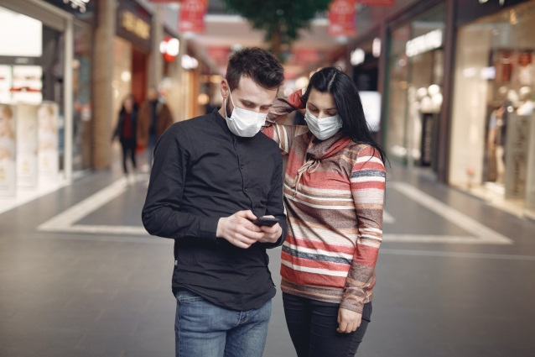
WHAT WE HAVE MEASURED
COVID AND SOCIETY
COVID AND ECONOMY
COVID AND MENTAL HEALTH
COVID AND THE FUTURE

Slide 6
COVID AND
SOCIETY
COVID AND ECONOMY
COVID AND MENTAL HEALTH
COVID AND THE FUTURE
Fear of covid affecting their health or that of their family.
Approval of government and other relevant actors (such as companies, congress, justice system, media, ongs, church, society in general, respondent, doctors and nurses, scientists, teachers, etc).
Social relations during quarantine.
The quarantine and restrictive measures. Approval. Difficulties. Restrictions and civil right.
Changes in hygiene habits/ prevention.
Changes in consumption habits.
Homeschooling.
Pets during covid.

Slide 7
COVID AND SOCIETY
COVID AND ECONOMY
COVID AND MENTAL HEALTH
COVID AND THE FUTURE
Personal impact of covid in economy vs health.
Impact in their own economy and expected impact in the future (inflation, unemployment, etc).
Impact in Argentina compared to other countries.
Impact of economic consequences of COVID vs. 2001 crisis.
Public opinion and the role of companies in the COVID era. Evaluation & expectations.

Slide 8
COVID AND SOCIETY
COVID AND ECONOMY
COVID AND
MENTAL HEALTH
COVID AND THE FUTURE
Mood in one word and in scale 1-10.
Incidence of Covid in Mental health (stress, depression, anxiety, loneliness, problems to sleep, consumption of psychoactive products, etc).
Impact of Covid in life satisfaction.
Impact of Covid in assessment of own health.

Slide 9
COVID AND SOCIETY
COVID AND ECONOMY
COVID AND MENTAL HEALTH
COVID AND THE FUTURE
Estimated timing for the end of covid.
Expected changes post pandemic in different personal and society levels:
work
personal relations
consumer habits
economy
politics
leisure
gym and health
priorities and values
world powers

Slide 10
METHODOLOGIES USED

Slide 11
Qual (groups and interviews online)
Telephone
Online via panels and recruiting in social media
E-mailing

Slide 12
CHALLENGES

Slide 13
METHODOLOGICAL CHALLENGES
Adaptation of methodologies in a region where face to face is the most representative method.
Not losing comparability (we have trends since early 80s in the country for many variables) and tracking variations adds enormous value.
Mastering mix mode.

Slide 14
OPERATIONAL
CHALLENGES
Speed/ timing. The situation is dynamic and timing is more key than ever.
International research: speed and changes in methodologies, etc. add complexity.
In research among key informants/ opinion leaders/ businesses/ institutions although the methodologies in general have not changed accessing the target is more difficult, though once you access the target in our experience they tend to respond more.
Funding is a big challenge

Slide 15
STRATEGIC
CHALLENGES
Conducting systematic research that can be consulted for immediate action & can be used for more deep analysis and understanding on changes in the future.

Slide 16
SOME INTERESTING FINDINGS

Slide 17
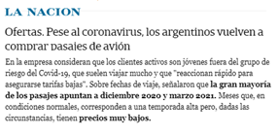
The power of qualitative research to get a deeper insight into public mood and specific groups.
We feel so vulnerable and so close to death that I noticed on Instagram that people were sharing things from their childhood and reliving it, and it gives me the feeling that it's like when you die and your life passes before you. We are feeling the closeness to death. (Adult; middle SEL)
The quarantine fed my desire to travel, to go and meet (Young, medium high sel)
Newspaper article shows that ticket sales are reactivated mainly among young people

Slide 18
3/4 fear for their own and family health, which is high in our international comparisons.
The government has a good assessment, but not the judicial and legislative powers.
Pets in households (represented by dogs mainly in Argentina) has helped people to bear their own quarantine.
Technology helps but Argentinians miss greatly hugs and human physical contact.
Time is still scarce, moreoever for people who work and have to help their children with homeschooling but in general all the population refers that the new routines take up most of their day.
HOME is resignified and many efforts are made to make it more confortable .
Problems of overcrowding in lower classes.
Solidarity and feeling of being part of something.
COVID AND SOCIETY

Slide 19
COVID AND ECONOMY
The economic situation is a main concern, the majority believes it will hit our country more than other countries and that It will be as severe or worse than 2001 crises, the hardest crises we faced with longstanding economic, political and social consequences.
We have been following the issue of the role of companies for decades and we see that at this time there is a growing expectation that companies will become actively involved in helping the community: 5 out of 10 interviewed declare to be aware of the actions that companies are carrying out in relation to the coronavirus.

Slide 20
COVID AND MENTAL HEALTH
The population is highly pessimistic, the worse is yet to come.
Strong impact in stress, depression, sleeping disorders, consumption of alcohol and tobacco. All negative mental states have increased. Young people express more difficulty to bear the quarantine and feel more negative feelings.

Slide 21
It is difficult to forecast changes in society post covid. Imagining the future respondents mention that “their own words shouldn’t be trusted completely” in our qual jobs.
They expect changes: in hygiene habits (washing hands more frequently), remote work from home and growing e-commerce. In the agenda: two serious debts became evident : problems in health system and inequality.
Future is uncertain and only time and new research will allow us to see and explain it better. But what we see in Argentina is that people want to return to their normal lives and mostly post pandemia worries are related to the economic problems and urgencies they are foreseeing with high unemployment, lower family incomes and deep recession.
COVID AND THE FUTURE

Slide 22
THANK YOU!
For further information
constanzacilley@voicesconsultancy.com

