Slide 1
The SEAN COVID-19 Survey Archive
WAPOR - Thursday, June 4, 2020
Gary Langer
President, Langer Research Associates
glanger@langerresearch.com

Slide 2
What is SEAN… and why this matters
Societal Experts Action Network (SEAN)
A panel of U.S. social science experts convened by the National Academies of Sciences, Engineering and Medicine in collaboration with the National Science Foundation.
Mission 1: Connect policymakers with critical social, behavioral and economic research into the COVID-19 pandemic.
Mission 2: Share this research with a broader audience – including the research community, the news media and the public at large.

Slide 3
Leveraging transparency for the public good
The SEAN COVID-19 Survey Archive seeks to create a one-stop shop for essential survey research into the pandemic.
An open-access, simple-to-use resource to search and retrieve individual survey questions and all related materials, where available – reports, data tables, datasets, scripted questionnaires, methodological disclosures and more.
The current collection, housed on our PARC knowledge management platform, includes more than 225 studies from more than 25 nations, including more than 75 datasets and more than 2,500 questions.

Slide 4
What’s in there?
To support inference, we archive data collected via probability samples –those based on sampling frames that include all or nearly all members of the target population, sampled so that all units in the frame have a known, nonzero probability of selection.
Per the Report of the Task Force on Online Panels of the American Association for Public Opinion Research (among other sources):
“Researchers should avoid nonprobability online panels when one of the research objectives is to accurately estimate population values.”
“There currently is no generally accepted theoretical basis from which to claim that survey results using samples from nonprobability online panels are projectable to the general population. Thus, claims of ‘representativeness’ should be avoided when using these sample sources.”

Slide 5
Benefits
Users can quickly locate essential research on precise topics of interest, with all supporting materials a click away.
Policymakers can assess the latest data on the public’s policy preferences, responses to initiatives and personal experiences and calibrate next steps accordingly.
The research community can learn from the existing knowledge base as it’s developed, assess the strength of research claims and seek to replicate and extend key findings.
The media and the public can stay well-informed on the latest survey data.
The archive supports the historical record of these difficult times.

Slide 6
Creating the SEAN archive
The Associated Press-NORC | Marist College
Axios | Marquette Law School
Central Force (Malaysia) | Monmouth University
CNN | NBC News
COVID Impact | NPR
Federal Reserve Bank of New York | PBS
FiveThirtyEight | Pew Research Center
Fox News | Siena College
Grinnell College | SSRS
Info Sapiens (Ukraine) | The Wall Street Journal
Infosearch (Thailand) | The Washington Post
Ipsos | University of Maryland
Kaiser Family Foundation | University of Southern California
M-Vector (Kyrgyzstan) | VCIOM (Russia)
Will survey producers and sponsors set aside their competitive interests in the spirit of contributing to a shared knowledge base?
Resoundingly, yes. Full contributors – including datasets – include:

Slide 7
Additional contributors:
ARD (Germany) | Fordham University | Public Policy Institute of California
Asahi Shimbun (Japan) | FSB Communications (Brazil) | Pulse Market Research (Cyprus)
Australian National University | Gallup International Bulgaria | Pulse Research and Consulting (Greece)
BISAM (Kazakhstan) | Gallup International Pakistan | Rating (Ukraine)
Bloomberg CCI | Gallup International South Korea | Quinnipiac University
Buendia & Laredo (Mexico) | High Point University | Research & Branding Group (Ukraine)
Cadem (Chile) | I&O Research (The Netherlands) | RTI International
California Health Care Foundation | Infotrak Research & Consulting (Kenya) | SESRI (Qatar)
Chicago Booth/Kellogg School | Infratest Dimap (Germany) | SHADAC
Cifras y Conceptos (Colombia) | John Hartford Foundation | SORA Institute for Social Research (Austria)
Comunicacion Politica (Mexico) | Levada (Russia) | The Commonwealth Fund
CVoter (India) | Lowy Institute Poll (Australia) | The SCAN Foundation
Datafolha (Brazil) | Luker on Trends | The University of Chicago Divinity School
DataPoder360 (Brazil) | Mainichi Shimbun (Japan) | Tifa Research (Kenya)
East Tennessee State University | Nanos (Canada) | TVBS (Taiwan)
El Financiero (Mexico) | NOI Polls (Nigeria) | United States Census Bureau
Federal Reserve Board | NORC | University of Mannheim (Germany)
FOM (Russia) | Novus (Sweden) | University of New Hampshire
 | Office for National Statistics (UK) | Urban Institute

Slide 8
Weekly summaries
In addition to the SEAN archive, we produce a weekly summary of key results from surveys released the previous week. Typical topics include:
Daily Life Reopening America
Contact and Concern Government Response
Health Impacts Impacts on Education
Health Care/Public Health Policies Voting in November
Vaccinations State and Local Results
Economic Impacts International Results

Slide 9
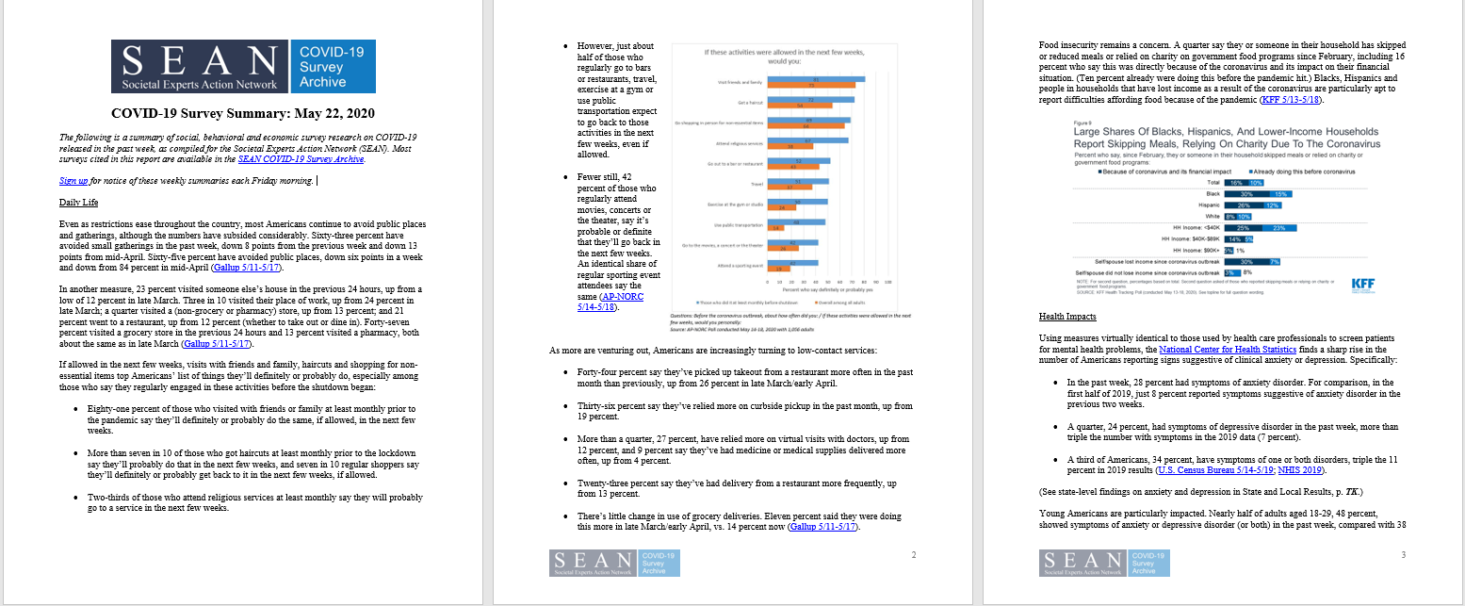
Sign up to receive the weekly summary at: https://covid-19.parc.us.com

Slide 10
Let’s look!
https://covid-19.parc.us.com

Slide 11
Thank you! The SEAN COVID-19 Survey Archive
WAPOR - Thursday, June 4, 2020
Gary Langer
President, Langer Research Associates
glanger@langerresearch.com

